Slide 1
Let’s Keep Rocking With ROULETTE SUPERHACKED PYTHONCODE SERIES !
🕉️ MR.AMAZONXYZAPOLLOKGF - AKHANDA MAHA BHARAT SAMRAAJYONKA MJSHARABHA CHAKRABORTY M-ONE KALKIKING MANIDWEEPON LOKTANTR SARVALOK JAGADEKAAISVARIVAAN sri sri kaveri veera bharat Bhushan 🕉

Slide 3
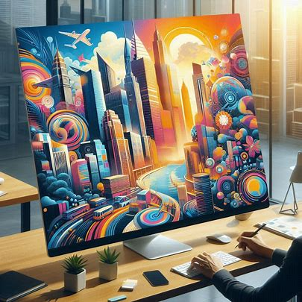

GRACIAS !!
🕉️ MR.AMAZONXYZAPOLLOKGF - AKHANDA MAHA BHARAT SAMRAAJYONKA MJSHARABHA CHAKRABORTY M-ONE KALKIKING MANIDWEEPON LOKTANTR SARVALOK JAGADEKAAISVARIVAAN sri sri kaveri veera bharat Bhushan 🕉

